Slide 1
Intro to Neural Nets
Week 3: Model Fitting

Slide 2
Today’s Agenda
General Workflow
Step 1: Get your model to overfit on training data (always possible).
Step 2: Get your model to fit to validation data (this is quite exploratory)
Step 3: Maximize out of sample performance by mitigating / delaying overfitting in training data.
Techniques to Mitigate Overfitting
Early stopping (we’ve seen this already, and we will do it regularly).
Regularizing or constraining weights
Dropout
Adjust batch size
Inject noise
Get better / more data
Some Rules of Thumb
Examples + Competition + Homework Assignment #1

Slide 3
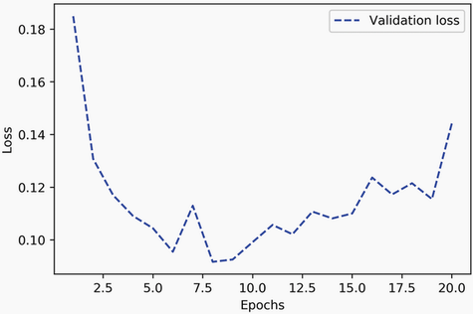
Early Stopping
Monitoring Validation Performance and then Manually Limiting Epoch Count
This is the sole approach we have been taking thus far.

Slide 4
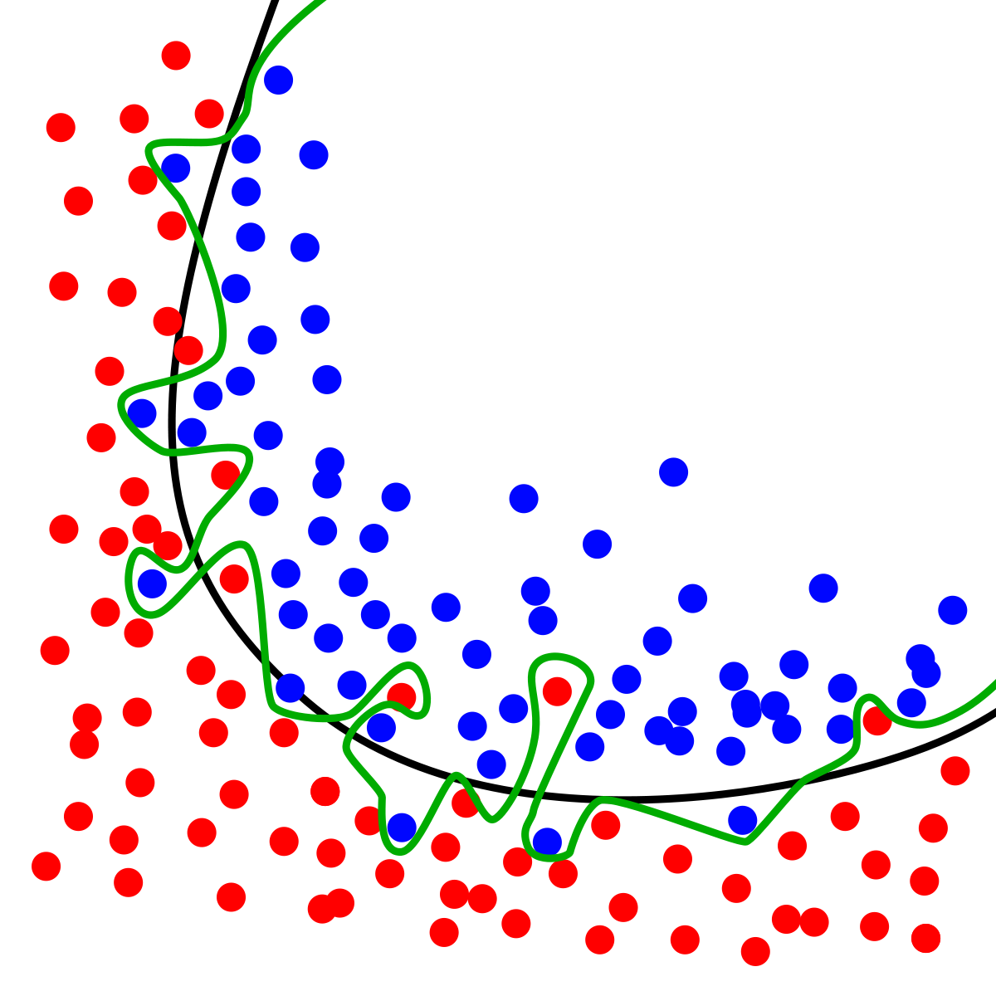
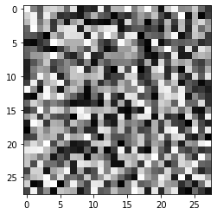
Overfitting
A Neural Network Can Easily Overfit…
Let’s look at an extreme case…

Slide 5
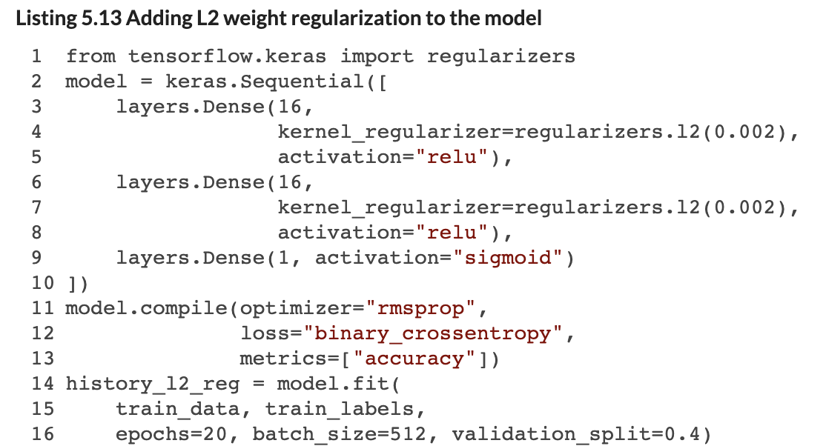
Regularizing Weights
Regularizing Weights Means Less Entropy
Regularizing a layer’s weights means the weights are updated less as their collective magnitude (e.g., sum) gets larger. Both L1 or L2 norms can be used here applied.
This approach is typically used to improve the validation performance of smaller networks.
Notes:
You can input L1 ỏ L2 instead of an integer

Slide 6
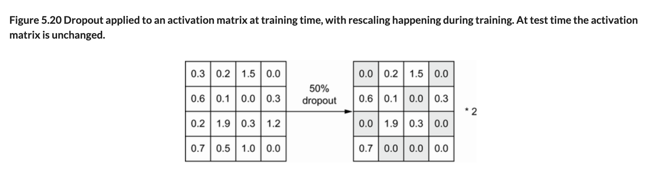
Dropout
Adding Dropout Layers to the Network
Dropout layers set a random proportion of edge weights to 0 in a given training iteration. Typically between 20% and 50% of edges.
When the final model is obtained, the 0’s are removed, and the output values are scaled down uniformly to account for the change in the number of edges.
This approach is more commonly used with large / deep networks.
Notes:
If you have multiple layers, you will get a drop out before that and it will randomly select 20% of edges and reduce it to 0. The whole idea is to slow down the overfitting of the data. In keras, there’s a layer called drop out layer

Slide 7
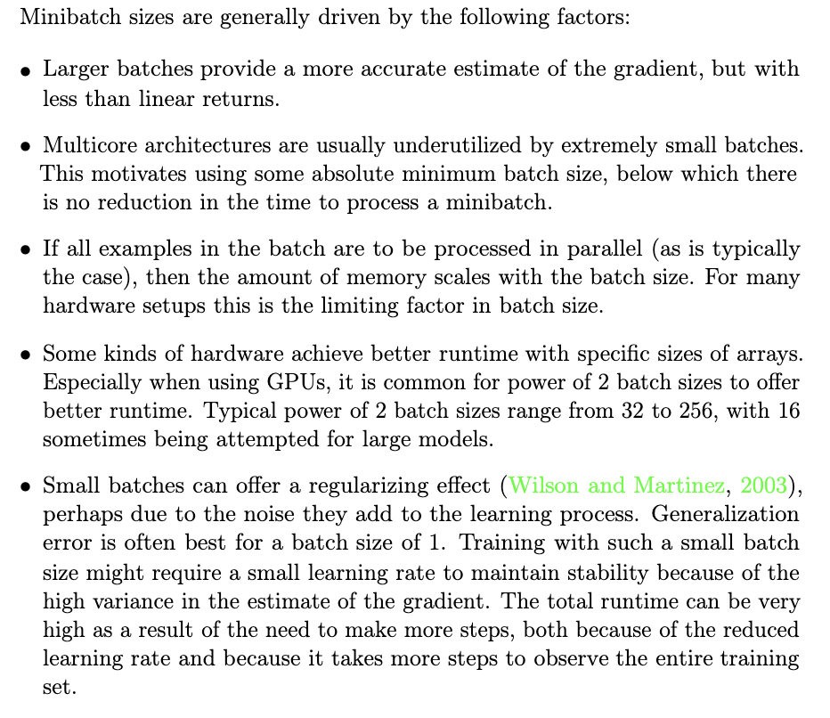
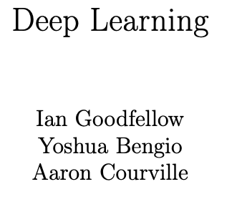
Adjust Batch Size
Notes:
We don’t really know why, it’s just a theory that people come up. Basically, if the batch size is small, make it bigger, and vice versa and see if it helps

Slide 8

Inject Noise
Just Like Smaller Batch Size, but Purposeful
One can manually jitter model weights at each iteration by ‘adding’ random noise.
You can add noise to any model component, including the inputs, activations and outcome labels.
Notes:
Adding noise to the input or adding noice to the weights.

Slide 9

Get More Data!
More Training Examples
Means you can have a bigger training data-set, which will presumably contain more information for the model to extract.
This is the approach that often yields the best marginal returns, though it can also be most costly.

Slide 10
Some Rules of Thumb
These Are Useful Guidelines for Your First Pass at a NN
Start with 2 hidden layers.
Give the first hidden layer (num_inputs / 2) nodes and the next (num_inputs / 4) nodes. If you add layers, decay the node count in this manner as you go along.
Use ReLU (or SeLU) activations for hidden layers.
Add Dropout at every layer after the input, with a rate of 0.5 (don’t push beyond 0.5).
If learning is flat, then more nodes in each layer.
Whiten continuous input data (demean, divide by standard deviation).
Make sure you are doing cross-validation, with a test set holdout.
For classification problems, apply class weights to balance labels (in the model.fit() function).
User RMSprop or Adam as your optimizer.
Choose an appropriate loss function!
Monitor accuracy as metric for classification problems, MSE for regression.
Start with 20 epochs, increase if the validation loss has not yet reached its low point.
Start with a batch size of 16 and then double it from there.
Notes:
First few layers with a few hundred nodes (because the first layers are bottle neck and you don’t want it to be too tight)
Whiten: meaning mean / std. Ovs doesn’t matter that much if you have binary input features
Be careful with your loss function because it can mess up your model. I have a continueous but you take binary cross entropy loss -> kinda stupid

Slide 11
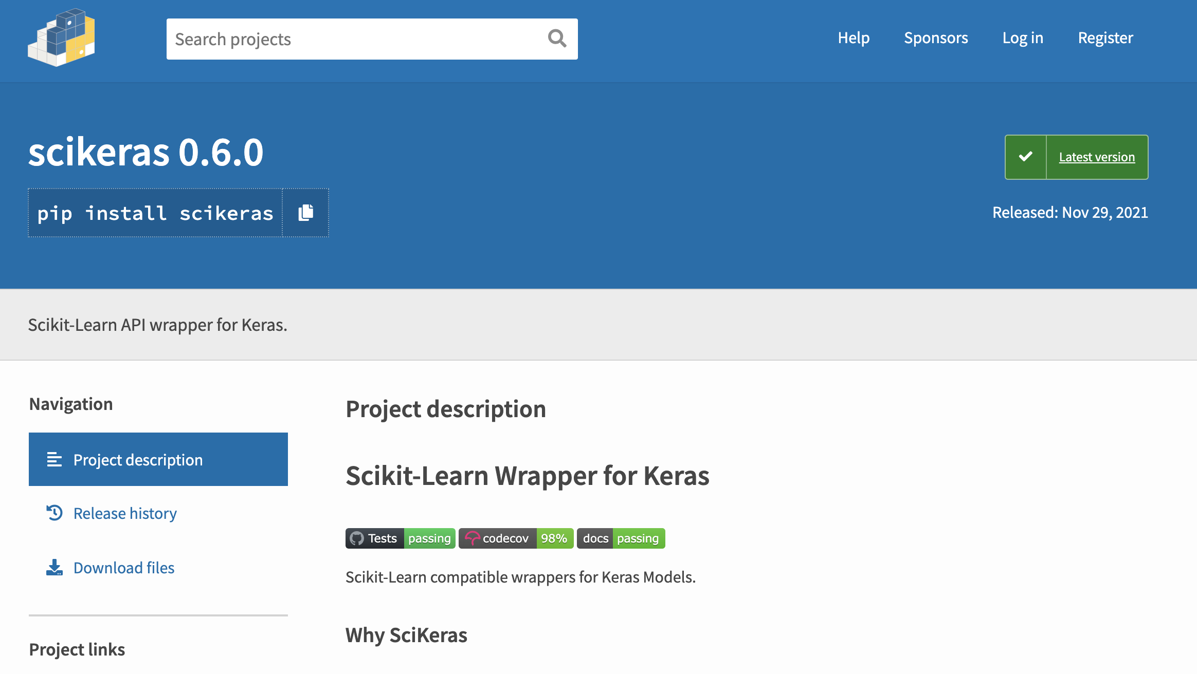
Scikit-Learn Wrapper for Keras
Facilitate Hyperparameter Tuning and Cross-validation of a Deep Net
These wrappers can be used with the Sequential API, with two caveats:
First, you need to formally specify the shape of the input layer.
Second, you need to install scikeras in Google colab to use it.

Slide 12
Let’s Walk Through Several Examples
Notes:
Note that I don’t expect you to implement a neural network from scratch. This is just to give you an understanding of how they work.

Slide 13
Homework Assignment #1
Basic Prediction Exercise
I am providing you with a sample of real data from the Blue Bikeshare service (Boston bikeshare).
Your goal is to use this data to predict how long an individual’s bike trip will last, in seconds.
Deliverable
Produce a Jupyter notebook documenting your work (include the names of the contributors at the top of your notebook).
Feel free to incorporate heavy comments so we (the TA and I) are clear what you were trying to do! Feel free to re-use code from class examples, but you should not collaborate with anyone else (outside your pair, if you decide to submit as a pair).
Pre-process the data as necessary; define your models, explain your thought process, e.g., around the choice of loss function, activation functions, network topology, etc.
Tune the model; describe what ‘experiments’ you ran exploring different configurations and report ultimate performance. You should be employing cross-validation, under a train, validation, test framework.
Notes:
Note that I don’t expect you to implement a neural network from scratch. This is just to give you an understanding of how they work.

Slide 14
Homework Rubric
Formatting (5%)
You should format your notebook, to present results in a clean and sequential way, with heavy commenting and/or textual explanation, as well as visualizations, to make your points clearly.
Data Processing / Preparation (5%)
Did you retain all features, or did you rely on a subset? If you dropped some features, which ones, and why?
Did you pre-process the data (e.g., hot-encoding, whitening) available features, to partition the data, etc.?
Did you do any feature construction? If so, what did you add?
Model Definition & Calibration (10%)
How did you structure your network? What activation functions did you employ? What loss function did you use and why? (Consider drawing a picture of your network topology).
What parameters did you tune, if any, and what values did you ultimately select? Note: I don’t expect you to be exhaustive in model tuning; explore a few parameters, e.g., epochs, node volumes, number of layers, different activation functions.
Model Evaluation (5%)
Did you implement cross-validation? How does your model perform on holdout sample.
Notes: I am keeping aside 1000 observations that I will not share with you until after the homework is graded. I will evaluate models based on mean absolute error.
Notes:
Note that I don’t expect you to implement a neural network from scratch. This is just to give you an understanding of how they work.

Slide 15
Start Working Now…
Notes:
Note that I don’t expect you to implement a neural network from scratch. This is just to give you an understanding of how they work.

